Slide 1

Architecture Support for System Security
Computer System Principles, Fall 2020 (IPADS, SJTU)
Building security from solid base
Yubin Xia

Slide 2
Security: Why Hardware?
Security is a negative goal
How to make a program not do something?
E.g., not execute any code from user, not leak some secret from memory, etc.
Hardware features based security
Fixed and robust (hopefully)
More efficient

Slide 3
SMEP/SMAP
SMEP: Supervisor Mode Execution Prevention
SMAP: Supervisor Mode Access Prevention

Slide 4
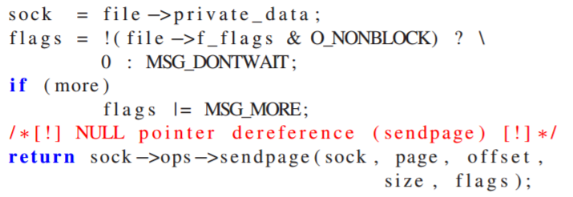
Return-to-user Attack
NULL function pointer in Linux (net/socket.c)
The value of sendpage is set to NULL
What will happen then?

Slide 5
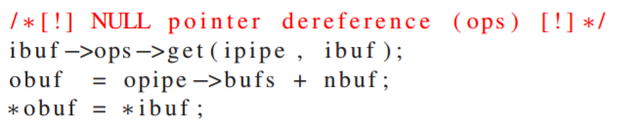
Return-to-user Attack
NULL data pointer in Linux (fs/splice.c)
The ops field becomes NULL after the invocation of the tee system call
Then get() will be at 0x0000001C, which is controlled by the app

Slide 6
SMAP
SMAP: Supervisor Mode Access Prevention
Allows pages to be protected from supervisor-mode data accesses
If SMAP = 1, OS cannot access data at linear addresses of application

Slide 7
SMEP
SMEP: Supervisor Mode Execution Prevention
Allows pages to be protected from supervisor-mode instruction fetches
If SMEP = 1, OS cannot fetch instructions from application
Introduced at Intel processors from Ivy Bridge
Security feature launched in 2011
Enabled by default since Windows 8.0 (32/64 bits)

Slide 8
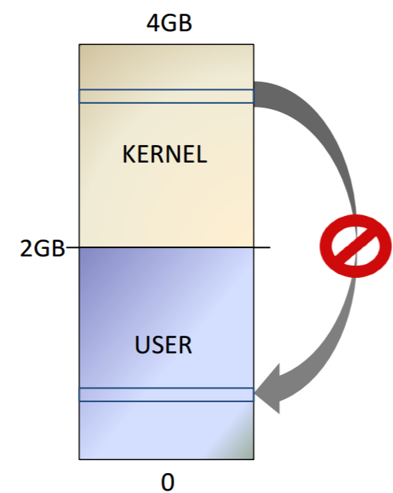
Prevent Return-to-user Attack
The CPU will prevent the OS from executing user-level instructions

Slide 9
SMEP CPU Support
Desktop processors
Intel Core: Latest models of i3, i5, i7
Intel Pentium: G20X0(T) and G21X0(T)
Intel Celeron: G1610(T), G1620(T) and G1630
Server processors
Intel Xeon: Latest models of E3, E5, E7
Intel Pentium: 1403v3 and 1405v2

Slide 10
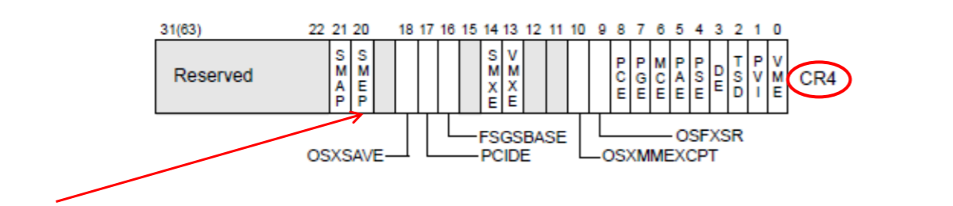
How to Bypass SMAP/SMEP?
1. Turn off the bit 20th/21st of the CR4 register
E.g., "mov rax,0xFFFEFFFFF" / "mov cr4,rax" / "ret "
Jump to USER SPACE

Slide 11
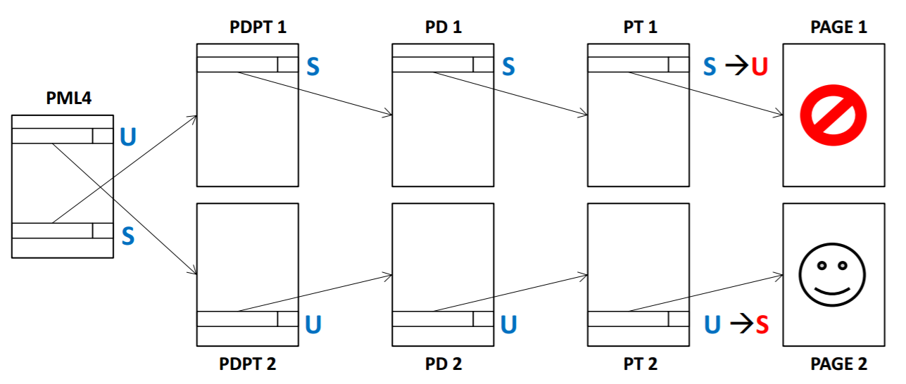
How to Bypass SMAP/SMEP?
2. Flipping the U/S bit
Notes:
https://labs.mwrinfosecurity.com/blog/2014/08/15/windows-8-kernel-memory-protections-bypass

Slide 12
MPX
Memory Protection eXtension

Slide 13
Bounds Error of Software
C/C++ programs are prone to bounds errors
Not type-safe language
E.g., buffer overflow bugs

Slide 14
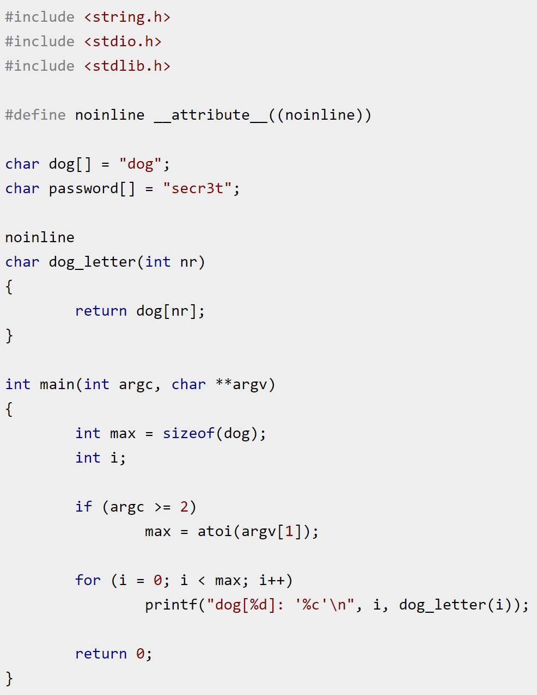
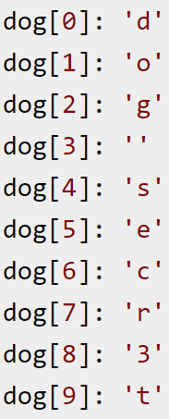
Bounds Error
Running that program with a bad input ("10" is longer than "dog") can yield unexpected results

Slide 15
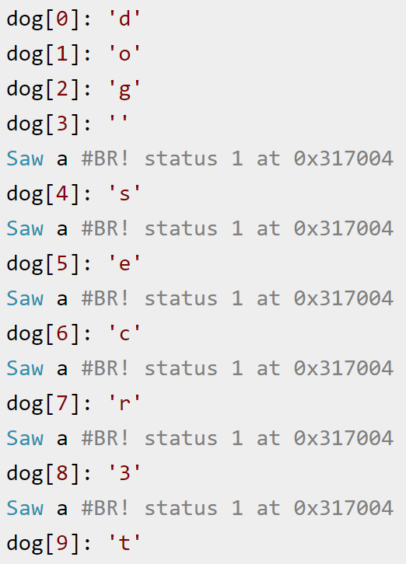
Bounds Error
gcc -Wall -o mpx-out-of-bounds -mmpx -fcheck-pointer-bounds mpx-out-of-bounds.c

Slide 16
MPX: Memory Protection eXtension
Intel introduces MPX from Skylake
Programmer can create and enforce bounds
Specified by two 64-bit addresses specifying the beginning and the end of a range
New instructions are introduced to efficiently compare a given value against the bounds, raising an exception when the value does not fall within the permitted range

Slide 17
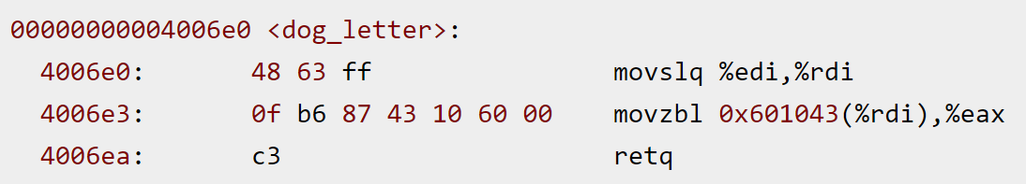
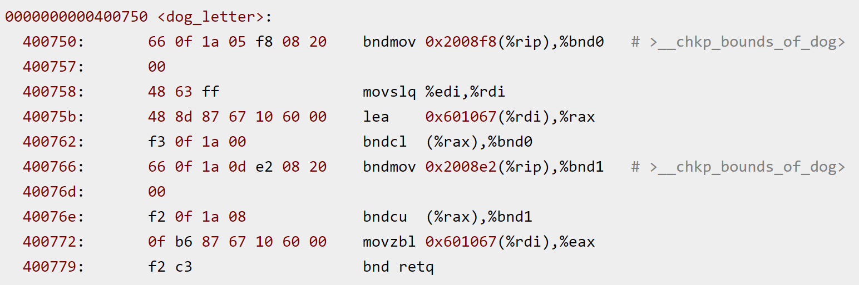
Using Intel MPX
Without MPX
With MPX

Slide 18
Intel MPX's New Instructions
bndmov: Fetch the bounds information (upper and lower) out of memory and put it in a bounds register.
bndcl: Check the lower bounds against an argument (%rax)
bndcu: Check the upper bounds against an argument (%rax)
bnd retq: Not a "true" Intel MPX instruction
The bnd here is a prefix to a normal retq instruction
It just lets the processor know that this is Intel MPX-instrumented code

Slide 19
Bounds Tables
For efficiency, four bounds can be stored into dedicated registers
Registers: bnd0 to bnd3
When more bounds are required, they are stored in memory, and the bound registers serve as a caching mechanism
Bounds tables are a two-level radix tree, indexed by the virtual address of the pointer for which you want to load/store the bounds
The BNDLDX/BNDSTX instructions essentially take a pointer value and move the bounds information between a bounds register & bounds tables

Slide 20
Memory Consumption
Bounds tables can consume and reference a lot of memory
A one-page (4 KB) data structure entirely filled with pointers will consume four pages (16 KB) of bounds tables because each bounds table entry contains four pointers' worth of data
In the worst case, bounds tables can cause an application to consume 500% more memory compared to if the application was not using MPX

Slide 21
Performance of MPX
While the bounds-checking itself is very efficient, the usage of many bounds is not
For instance, GCC's implementation of MPX buffer checking frequently spills bounds registers to memory

Slide 22
How to Use MPX?
make CFLAGS="-mmpx -fcheck-pointer-bounds -lmpx" LDFLAGS="-lmpxwrappers -lmpx"
# ldd ./mpx-out-of-bounds
linux-vdso.so.1 (0x00007ffc4f5aa000)
libmpx.so.0 => /lib64/libmpx.so.0 (0x00007ff42d223000)
libmpxwrappers.so.0 => /lib64/libmpxwrappers.so.0 (0x00007ff42d021000)
libc.so.6 => /lib64/libc.so.6 (0x00007ff42cc5f000)
libpthread.so.0 => /lib64/libpthread.so.0 (0x00007ff42ca42000)
/lib64/ld-linux-x86-64.so.2 (0x0000558cb43be000)

Slide 23
MPK
MPK: Memory Protection Keys

Slide 24
MPK: Memory Protection Keys
With MPK, every page belongs to one of 16 domains
A domain is determined by 4 bits in every page-table entry (referred to as the protection key)
For every domain, there are two bits in a special register (pkru)
Denote whether pages associated with that key can be read or written
Kernel and application
Only the kernel can change the key of a page
Application can read and write the pkru register using the rdpkru and wrpkru instructions respectively

Slide 25
MPK: Memory Protection Keys
Isolation can be enabled using MPK by placing the sensitive data in pages that have a particular protection key, forming the sensitive domain
An appropriate instrumentation enables reads and/or writes to the data by setting the access disable and write-disable bits, respectively, using wrpkru
As long as these bits are unset, the sensitive domain is accessible
By setting the bits back, the sensitive domain is disabled, making only the non-sensitive domain available

Slide 26
MPK is not "New"
Similar software implementation: using mprotect()
Application can already change the permission of pages
Why is MPK needed?
Hardware for efficiency
Page table entries are expensive to manipulate
Require system call
A change requires invalidating translation lookaside buffer (TLB)
Using MPK, application can frequently change memory permission

Slide 27
Use Cases of MPK?
Use case 1: protect critical data
Handling of sensitive cryptographic data
Only enable access to private key during encryption
Use case 2: prevent data corruption
In-memory database prevents writes most of the time
Only enable changing data when needs to change
Changing protection on gigabytes using mprotect() is too slow

Slide 28
ARM PA
PA: Pointer Authentication

Slide 29
ARM Pointer Authentication
ARM64 only use 40 bits out of 64 bits
On an ARM64 Linux system using three-level page tables, only the bottom 40 bits are used, while the remaining 24 are equal to the highest significant bit
The 40-bit address is sign-extended to 64 bits
Those uppermost bits (or a subset thereof) could be put to other uses, including holding an authentication code
Use the 24 bits for security!

Slide 30
Key Management
PA defines five keys
Four keys for PAC* and AUT* instructions (combination of instruction/data and A/B keys),
One key for use with the general purpose PACGA instruction
Key storage
Stored in internal registers and are not accessible by EL0 (user mode)
The software (EL1, EL2 and EL3) is required to switch keys between exception levels
Higher privilege levels control the keys for the lower privilege levels
Notes:
The Pointer Authentication specification defines five keys. Four keys for PAC* and AUT* instructions (combination of instruction/data and A/B keys), and a fifth key for use with the general purpose PACGA instruction. The keys are stored in internal registers and are not accessible by EL0 (user mode), but otherwise are not tied to exception levels. The software (EL1, EL2 and EL3) is required to switch keys between exception levels as needed. It is expected that higher privilege levels control the keys for the lower privilege levels. The instruction encoding determines which key to use. The context is useful for isolating different types of pointers used with the same key. The context is specified as an additional argument together with the pointer when computing and verifying the PAC

Slide 31
New Instructions
PAC value creation
Write the value to the uppermost bits in a destination register alongside an address pointer value
Authentication
Validate a PAC and update the destination register with a correct or corrupt address pointer
If the authentication fails, an indirect branch or load that uses the authenticated, and corrupt, address will cause an exception
Removing a PAC value from the specified register

Slide 32
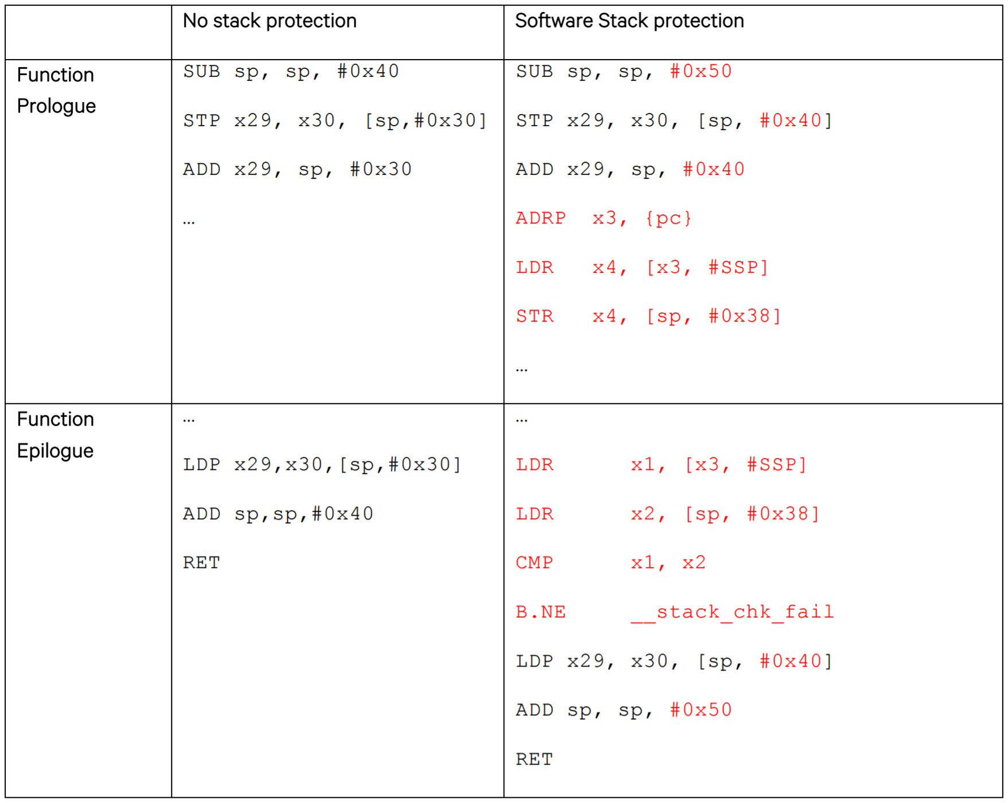
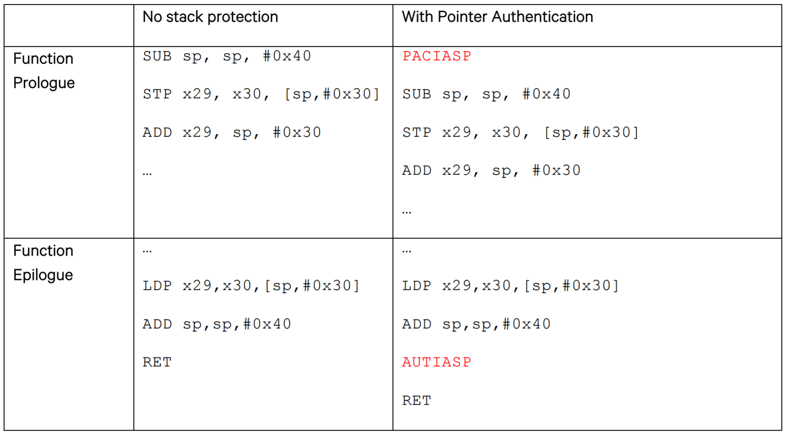
Use Case: Software Stack Protection

Slide 33
CET
Control-flow Enforcement Technology

Slide 34
Intel CET
Control-flow Enforcement Technology
Two major techs
Shadow stack
Indirect branch tracking

Slide 35
Shadow Stack
A shadow stack is a second stack for the program
Used exclusively for control transfer operations
Is separate from the data stack
Can be enabled for operation individually in user mode or supervisor mode

Slide 36
Shadow Stack Mode
CALL instruction
Pushes the return address on both the data and shadow stack
RET instruction
Pops the return address from both stacks and compares them
If the return addresses from the two stacks do not match, the processor signals a control protection exception (#CP)
Note that the shadow stack only holds the return addresses and not parameters passed to the call instruction

Slide 37
Protecting the Shadow Stack
The shadow stack is protected by page table
Page table support a new attribute: mark page as "Shadow Stack" pages
Control transfers are allowed to store return addresses to the shadow stack
Like near call, far call, call to interrupt/exception handlers, etc.
However stores from instructions like MOV, XSAVE, etc. will not be allowed
When control transfer instructions attempt to read from the shadow stack
Access will fault if the underlying page is not marked as a "Shadow Stack" page
Detects and prevents conditions that cause an overflow or underflow of the shadow stack or any malicious attempts to redirect the processor to consume data from addresses that are not shadow stack addresses

Slide 38
Indirect Branch Tracking
New instruction: ENDBRANCH
Mark valid indirect call/jmp targets in the program
Becomes a NOP on legacy processor
On processors that support CET the ENDBRANCH is still a NOP and is primarily used as a marker instruction by the in-order part of the processor pipeline to detect control flow violations

Slide 39
WAIT_FOR_ENDBRANCH State
The CPU implements a state machine that tracks indirect jmp and call
When one of these instructions is seen, the state machine moves from IDLE to WAIT_FOR_ENDBRANCH state
In WAIT_FOR_ENDBRANCH state the next instruction in the program stream must be an ENDBRANCH
If an ENDBRANCH is not seen the processor causes a control protection fault else the state machine moves back to IDLE state

Slide 40
Part-2 Hardware Features Not Designed for Security

Slide 41
Intel TSX
TSX: Transactional Synchronization eXtensions

Slide 42
Transactional Memory 101
Hardware TM to mass market
Intel's restricted transactional memory (RTM)
IBM's IBM Blue Gene/Q
AMD advanced synchronization family (ASF proposal)
Generally provides:
Opportunistic concurrency
Strong atomicity: read set & write set
Semantic of both all-or-nothing and before-or-after
Real-world best-effort TM
Limited read/write set
System events may abort an TX
✓

Slide 43
Programming with RTM
If transaction starts successfully
Do work protected by RTM, and then try to commit
Fallback routine to handle abort event
If abort, system rollback to _xbegin, return an abort code
Manually abort inside a transaction
if _xbegin() == _XBEGIN_STARTED:
if conditions:
_xabort()
critical code
_xend()
else
fallback routine
No conflict

Slide 44
Programming with RTM
If transaction start successfully
Do work protected by RTM, and then try to commit
Fallback routine to handle abort event
If abort, system rollback to _xbegin, return an abort code
Manually abort inside a transaction
if _xbegin() == _XBEGIN_STARTED:
if conditions:
_xabort()
critical code (access x)
_xend()
else
fallback routine
Another process
x = 1
Conflict!
Abort

Slide 45
Programming with RTM
If transaction start successfully
Do work protected by RTM, and then try to commit
Fallback routine to handle abort event
If abort, system rollback to _xbegin, return an abort code
Manually abort inside a transaction
if _xbegin() == _XBEGIN_STARTED:
if conditions:
_xabort()
critical code
_xend()
else
fallback routine
Manually
abort

Slide 46
Using HTM for Data Protection
Idea: leverage the strong atomicity guarantee provided by HTM to defeat illegal concurrent accesses to the memory space that contains sensitive data
Each private-key computation is performed as an atomic transaction
During the transaction
Private key is first decrypted into plaintext
Use to decrypt or sign messages
If the transaction is interrupted, the abort handler clears all updated but uncommitted data in the transaction
Before committing the computation result, all sensitive data are carefully cleared
Protecting Private Keys against Memory Disclosure Attacks using Hardware Transactional Memory, S&P'15

Slide 47
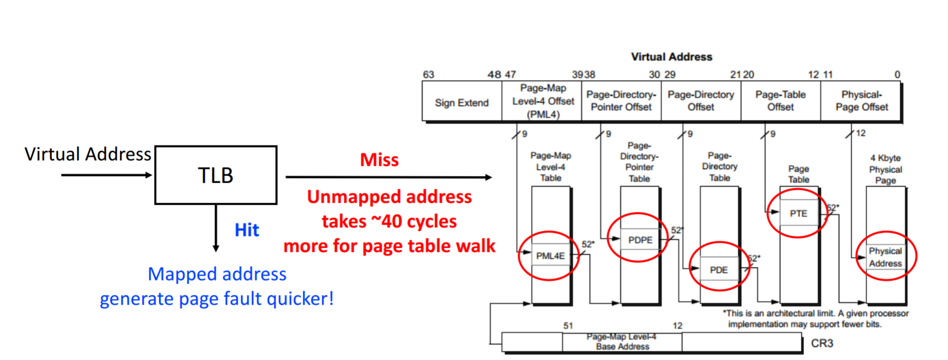
Using TSX for Attack KASLR
TLB Timing Side Channel
Breaking Kernel Address Space Layout Randomization with Intel TSX, CCS'16

Slide 48
Intel CAT
CAT: Cache Allocation Technology

Slide 49
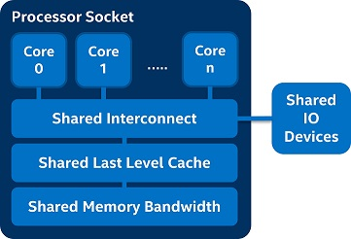
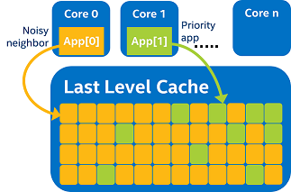
The "Noisy Neighbor" Problem
"noisy neighbor" on core zero over-utilizes shared resources in the platform, causing performance inversion
Though the priority app on core one is higher priority, it runs slower than expected

Slide 50
Software Controlled Cache Allocation
The basic mechanisms of CAT include:
The ability to enumerate the CAT capability and the associated LLC allocation support via CPUID
Interfaces for the OS/hypervisor to group applications into classes of service (CLOS) and indicate the amount of last-level cache available to each CLOS
These interfaces are based on MSRs
Model-Specific Registers

Slide 51
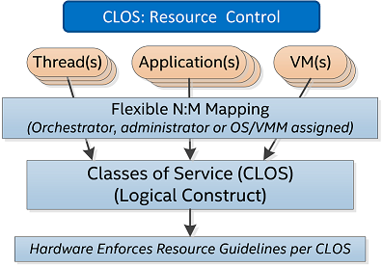
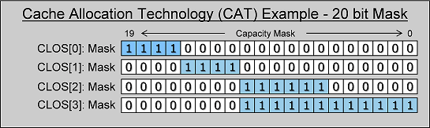
Class of Service (CLOS)
CLOS acts as a resource control tag into which a thread / app / VM / container can be grouped
CLOS in turn has associated resource capacity bitmasks (CBMs) indicating how much of the cache can be used by a given CLOS

Slide 52
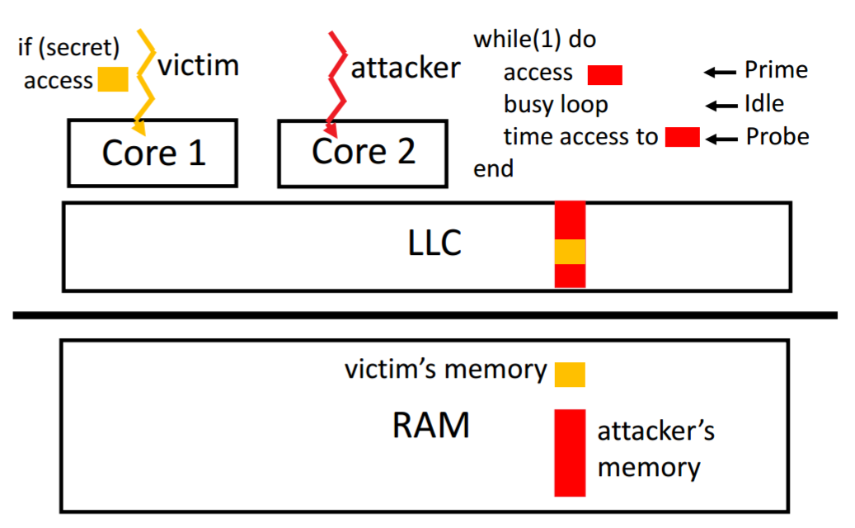
The PRIME+PROBE Attack

Slide 53
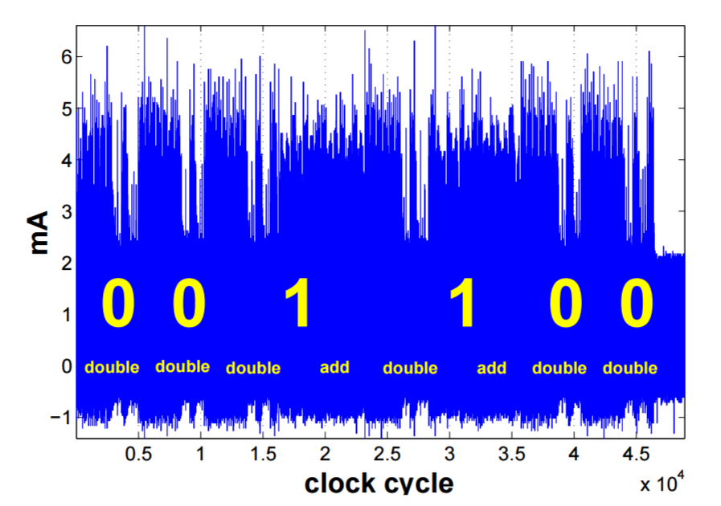
Cache Side-channel Attack
An attacker uses the side-channel information from one measurement directly to determine (parts of) the secret key
A simple analysis attack exploits the relationship between the executed operations and the side-channel information

Slide 54
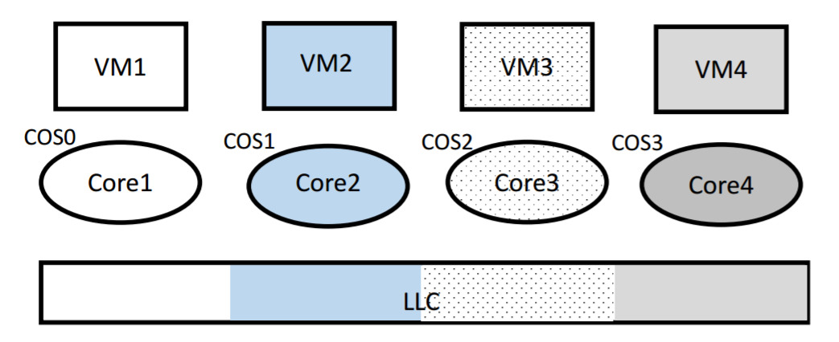
Use CAT to Mitigate Cache Side-channel Attack
Partitioning of the LLC between cores using CAT
CATalyst: Defeating Last-Level Cache Side Channel Attacks in Cloud Computing

Slide 55
PMU
PMU: Performance Monitor Unit

Slide 56
Monitor Control Flow by Existing PMU
PEBS: Precise Performance Counter
Save samples in memory region for batching
Atomic-freeze: record exact IP address precisely
BTS: Branch Trace Store
Capture all control transfer events
Also save exact IP in memory region
LBR: Last Branch Record
Save samples in register stack, only 16 pairs
Event Filtering
E.g. "do not capture near return branches"
Only available in LBR, not BTS
Conditional Counting
E.g. "only counting when at user mode"
Completeness
Accuracy
Efficiency
Trace Samples
0xff01cb -> 0xff01bb
0xff01c0 -> 0xff01fb
…
0xff01cb -> 0xff01bb
0xff01c0 -> 0xff01fb

Slide 57
Motivation: Code Injection Attack
A Typical Buffer Overflow Attack
Inject malicious code in buffer
Overwrite return address to buffer
Once return, the malicious code runs
void function(char *str) {
char buf[16];
strcpy(buf,str);
}
01010110101010111010
return addr
ebp
saved ebp
0110110101010101010101101010101010101010
Solutions
StackGuard^{[Cowan'98]}, FormatGuard^{[Cowan'98]}
Make data section non-executable
New Attacks: Code-reuse Attack
Return-to-libc & return-oriented programming
buf

Slide 58
Motivation: Code Reuse Attack
Return-oriented Programming
Find code gadgets in existed code base
Usually 1-3 instructions, ends with 'ret'
In libc and application, intended and unintended
Push address of gadgets on the stack
Leverage 'ret' at the end of gadget to connect each code gadgets
No code injection
Solutions
Return-less kernels ^{[Li'10]}
Heuristic means
New: Jump-oriented attacks ^{[Bletsch'11]}
Use gadget as dispatcher
0101011010
0101011010
0101011010
return addr
0101011010
saved ebp
0101011010
0101011010
0101011010

Slide 59

Motivation: CFI
General Solutions to Enforce CFI
Some need binary re-writing or source re-compiling
Some need application/OS/Hardware re-designing
Some have large overhead (3.6X for LIFT and 37X for TaintCheck)
Challenges
Non-intrusive general attack detection
Apply to existing applications on commodity hardware
Observations
Performance counters can be leveraged to monitor CFI

Slide 60
The Main Idea
Leverage PMU for CFI Monitoring
Using already existing hardware
No need to modify software
Two Phases
Offline phase: Get all the legal targets for each branch source
Online phase: Monitor all branches and detect malicious ones

Slide 61
Branch Types
In Apache and its libraries
Direct Branches
Direct call
Direct jump
Indirect Branches
Return
Indirect call
Indirect jump
Types | In Binary | Run-time
Direct call | 16.8% | 14.5%
Direct jump | 74.3% | 0.8%
Return | 6.3% | 16.3%
Indirect call | 2.1% | 0.2%
Indirect jump | 0.5% | 68.3%
has 1 target: 94.7%
<= 2 targets: 99.3%
>10 targets: 0.1%

Slide 62




Target Address Sets
Target Sets for Indirect Branches
ret_set: all the addresses next to a call
call_set: all the first addresses of a function
train_sets: all the target addresses that once happened
Return
Illegal
Indirect call
Illegal
Indirect jump
Suspicious
unknown source
ret_set
Illegal
call_set
train_sets

Slide 63
Intel PT
Intel PT: Intel Processor Tracing

Slide 64
Intel Processor Tracing (IPT)
Privileged agent configures IPT per core
Define memory location and size for tracing
3 filtering mechanisms: CPL, CR3, IP range
Efficiently captures various information
Control flow, timing, mode change, etc.

Slide 65
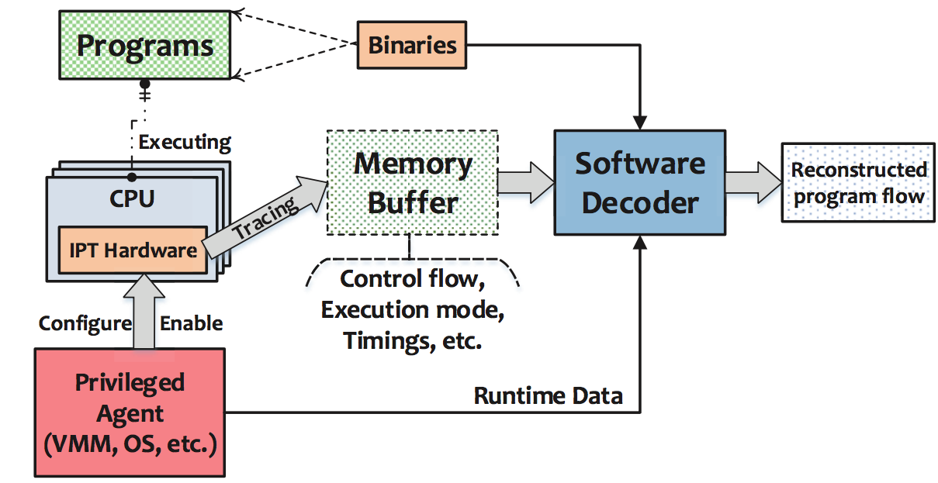
Background: IPT Overview

Slide 66
Challenges: Fast Trace vs. Slow Decode
IPT uses aggressive compression
Unconditional direct branches are not logged at all
Conditional branches are compressed to a single bit
Each indirect branch is traced as one target address
Result in average <1 bit per retired instruction

Slide 67
Challenges: Fast Trace vs. Slow Decode
Performance overhead is shifted from tracing to decoding
Decoding is several orders of magnitude slower than tracing
 | Precise | Tracing | Decoding | Filtering
BTS | Full | Slow (50X) | Fast | None
LBR | Low | Very Fast (< 1%) | Fast | CPL, CoFI
IPT | Full | Fast (3%) | Slow (200X) | CPL, CR3, IP

Slide 68
FlowGuard
FlowGuard: transparent, efficient and precise CFI
Transparent: no source code needed, no hardware change
Precise: enforce fine-grained CFI with dynamic information
Efficient: reconstruct CFG and separate fast and slow paths
Evaluation results
Apply FlowGuard to real machine with server workloads
Prevent a various of real code reuse attacks
Less than 8% performance overhead for normal use cases

Slide 69
FlowGuard Architecture
1
Static
Binary
Analysis
Process
Executable
Credit
Labeled
ITC-CFG
Libraries
Dynamic
Fuzzing
Training
2
User
4
Kernel
Kernel
Module
Syscall Interceptor
Flow
Checker
Cores
3
5
Fast
Path
Slow
Path
Memory
Notes:
IWe propose FlowGuard, which can transparently, efficiently and precisely enforce CFI.
For transparency, it generate CFG without source code and instrumentation, and enforce CFI with existing hardware.
For precision, it leverage IPT to trace control flow, and enforce CFI in a fine-grained manner with dynamic information
For efficiency, it reconstruct CFG to IPT compatible one, and separate the fast path and slow path for performance consideration.
And we implement a working prototype in Intel machine, using flowguard, we can prevent a various of code reuse attacks, and introduce averagely 6% performance overhead for server applications.

Slide 70
Using IPT for CFI
Privileged agent configures IPT per core
Define memory location and size for tracing
Efficiently captures various information
Control flow, timing, mode change, etc.

Slide 71
CFG Generation Overview
Conservatively generate CFG with static binary analysis
Reconstruct the CFG to be IPT compatible (ITC-CFG)
Label the edges of ITC-CFG with credits using dynamic fuzzing training
Process
Executable
Static
Binary
Analysis
CFG
Intel PT Compatible Reconstruction
ITC-CFG
Libraries
Dynamic
Fuzzing
Training
Credit
Labeled
ITC-CFG

Slide 72
ITC-CFG Construction Example
IPT traced data can be directly matched on the ITC-CFG
BB-1
Indirect edge
Direct edge
BB-2
BB-3
BB-2
BB-3
BB-5
T
BB-4
BB-5
BB-6
N
BB-7
BB-8
BB-9
BB-10
BB-7
BB-9
BB-10
(a). Traditional CFG
(b). ITC-CFG
Notes:
Here is the example.
As the picture shows, BB-2 is left because there is a indirect edge connected to it from BB-1, while BB-4 is discarded, since there is no incoming indirect edge for it.
On the other hand, BB-2 is connected to BB-7, because there is one indirect edge in the path from BB-2 to BB-7, and this indirect edge is the first indirect edge in this path.
We do it like this, is because it is exactly how IPT trace the TIP packet. Since IPT will only trace target addresses of indirect branches, thus we only preserve basic block as at least on indirect branches. Suppose currently, the PC is in BB-2, then the next possible TIP packet that will be traced by IPT can only be BB-7 or BB-9, because they are the only first indirect branch targets from BB-2.

